Slide 1

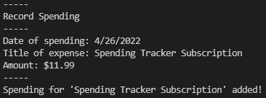
Spending Tracker By: Grayson Ball
An application to track and monitor spending
ksu-is/Spending-Tracker: (github.com)

